Slide 1
DLaRS
Decentralized Land Registration System
https://github.com/DaasDaham/DLaRS

Slide 2
Contents
01
Motivation and Idea
What inspired us to create DLaRS
02
Technology Used
Highlights the technologies used to compile, test and deploy
03
System Design
Brief system design and an infographic to detail it
04
Implementation Details
How we implemented the contract

Slide 3
Motivation
& Idea

Slide 4

Motivation
Decentralized
Land Registration
System
Traditional land registry system records are maintained by a central local ledger, which can lead to tainting and forgery of records. We can reduce these threats by creating a decentralized land registry system based on blockchain technology.
Notes:
Traditionally land registry systems have a central entity which registers

Slide 5

Idea
Land Registry is generally a centralized process. We propose to bring the process of land registry to a distributed ledger to introduce trust and transparency in the process. Specifically, we design smart contracts for the advertisement of land by the owner, request by a prospective buyer to view the details of the land or place a bid,, acceptance of bid by the seller, and the exchange of ownership.

Slide 6







Technology Used
Ganache
Solidity
Solidity v0.8 series is the most recent version of the solidity language which we have used.
Remix IDE
To compile and deploy our smart contract we also used Remix IDE. Javascript VM, a test network for the Ethereum chain, was used for deployment and testing.
Ganache
To create dummy accounts and examine all transaction happening under our DLaRS application.
Web3
Used this library to interact with the local ethereum nodes and connect our react application with our solidity code.
Metamask
Cryptocurrency wallet we used to interact with the Ethereum blockchain to sign transactions and transfer tokens.
React
Used to create the UI of our DLaRS application.
Truffle
Testing environment to compile our solidity code and deploy the blockchain to ganache

Slide 7

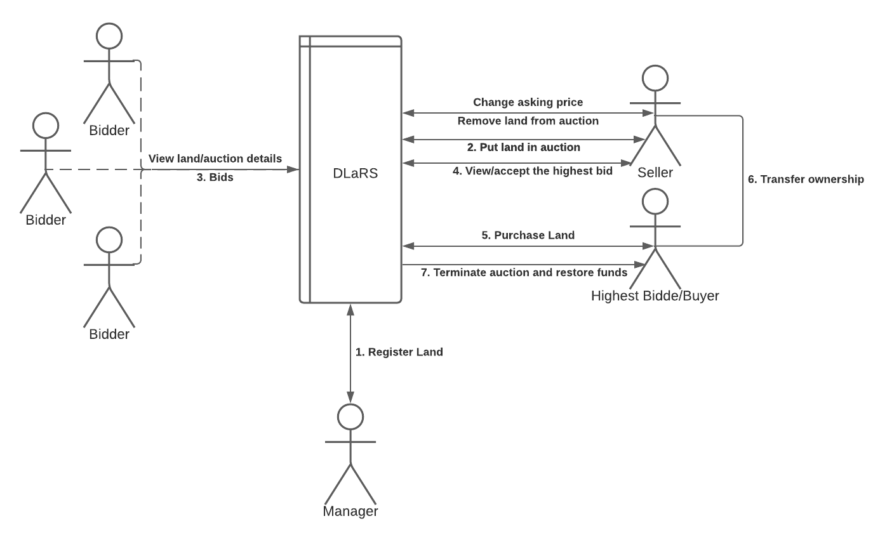
System Design
Our model consists of four entities: Seller, Bidder, Buyer and Manager.
Owner/Seller - This is the person who owns the land and wants to sell it through auction on the platform. They can also view and accept the highest bid.
Bidder - Bidders place bids greater than the asking price.
Buyer - Buyer is one of the bidders selected by the owner to sell their land. They are the highest bidder. The land will be transferred to the buyer’s address.
Manager - The manager is responsible for registering the land of a specified owner and adding it to the ledger.

Slide 8
Implementation
Details

Slide 9
Features Categorization
Seller
putUpForAction(), deleteFromAuction(), updateAuctionDetials(), acceptHighestBid() and transferOwnership().
Manager
registerLand().
Bidder
placeBid() and terminateAuction().
Everyone
viewLandDetials(), computeIdLand(), viewAuctionDetails()

Slide 10
Seller
putUpForAuction(): To put up land for auction, the seller specifies the asking price from which the auction will start. The land’s status is changed to underBidding indicating that it is currently under some auction. A new entry is created in the list of auctions.
deleteFromAuction(): This function removes the land from the auction process. The condition is there should not be any bid for the land yet.
updateAuctionDetails(): This function allows the seller to update the asking price and minimum bid raise amount for the auction if there has not been a bid on the land yet. This will be useful if the seller realises they have asked too high a price for the land.
acceptHighestBid(): This function would prompt the contract to stop bidding for the auction and accept the current highest bid (if any) and complete the sale. This takes care of transferring the ownership from the seller to the buyer. Changes the status of the land to ‘registered’ as the new buyer can again choose to put it up for auction. Calls the transferOwnership() function.
transferOwnership(): This function will change the land’s owner from seller to buyer. This is a private function only called through acceptHighestBid() function.

Slide 11
Manager
registerLand(): This function would be used to add the land to the DLaRS system. The manager would be required to add the address, city, country and Pincode of the land along with the owner’s address. The status of the land is also set as registered. If a land is already registered, then it cannot be registered again by the manager.

Slide 12
Bidder
placeBid(): This function would be used to place bids by the bidders in a given auction. It checks if the bid amount is greater than the amount by the previous highest bidder, if it is then, update the highest bidder with the current bidder and update the highest bid with the current amount; it also returns the money of the previous highest bidder to their address. Moreover, it also ensures the current bidder is not the owner.
terminateAuction(): This function will give the highest bidder the power to transfer the ownership of the land to themselves if their bid has not been accepted for a long time like 30 days. Changes the status of the land to ‘registered’ with highest bidder as new owner.

Slide 13
Everyone
viewLandDetails(): This function lists the details of land given land id.
computeIdLand(): Given the details of the land, this function uses a deterministic hash function that gives a unique id corresponding to the land.
viewAuctionDetails(): This function returns the auction specific details given a land ID.

Slide 14
Control Flow
Manager registers land
Bidders view land or auction details and put up a bid.
Seller gets the highest bid transferred to their account and ownership of land is transferred.
1
3
5
2
4
6
Seller
Seller puts the land up for auction.
Seller views the highest bid and accepts it.
If the bid is not accept within 30 days, the highest bidder has the option to terminate the auction.
Seller Puts the land up for auction

Slide 16
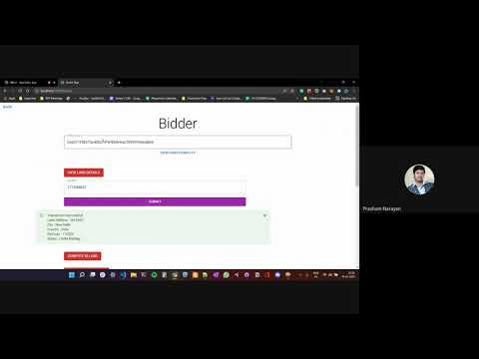
Demo Video

Slide 17



OUR TEAM
Aman Aggarwal
Prasham Narayan
Saad Ahmad
2018327
2018359
2018409

Slide 18
Thank you

